Slide 1
LGVSD
Administration building
Site selection
Notes:
Thank you for allowing us to be part of the process.
Thank you for taking a look at the opportunities that the site presents. This is helpful for designing the most functional and cost effective facility that will serve the District in the future.

Slide 2
Land use causes climate change which is the greatest threat to our existence.
Preserve land.
Build on stable ground and not in the mud.
Notes:
Land affects both global warming and our Health. How can we be of help?
We need to preserve land
Build on stable ground

Slide 3
Sea level rise is a threat!
The Environmental Impact Report with Mitigated Negative Declaration was prepared for Las Gallinas Valley Sanitary District by Albert A. Webb Associates on May, 2016.
The recommendation stated that the minimum elevation as it relates to the future sea level rise and storm surge is at EL 18.0 (NAVD 88), which is approximately 6 feet higher than the existing parking lot.
Notes:
We need to Plan for the inevitable. The ocean is rising.
The 2016 EIR for the District recommended building 6 feet above existing parking lot level.
The building is to survive more than 100 year,
We need to plan for it.

Slide 4
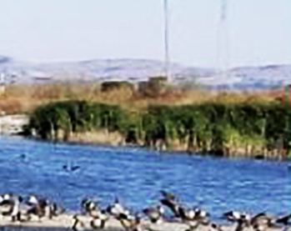
Reduced footprint
Opportunity to expand facility in the future.
Improve critical habitat and introduce measures to counter sea level rise.
Create opportunities for community engagement and public education.
Align with the District’s Strategic Plan.
Notes:
District has the opportunity to reduce the footprint. save land for future needs, and to engage the community.
This is great possibility District to demonstrate compliance with its Strategic Plan through the site selection

Slide 5
Staff Satisfaction
Health – Physical and Psychological
Engage and Motivate
Invest and Retain
Notes:
Site selection impacts the collective culture of the business. Helping staff perform successfully relates to how long they remain at their current place of employment, and most importantly how much they are motivated, engaged, and love their environment.

Slide 6
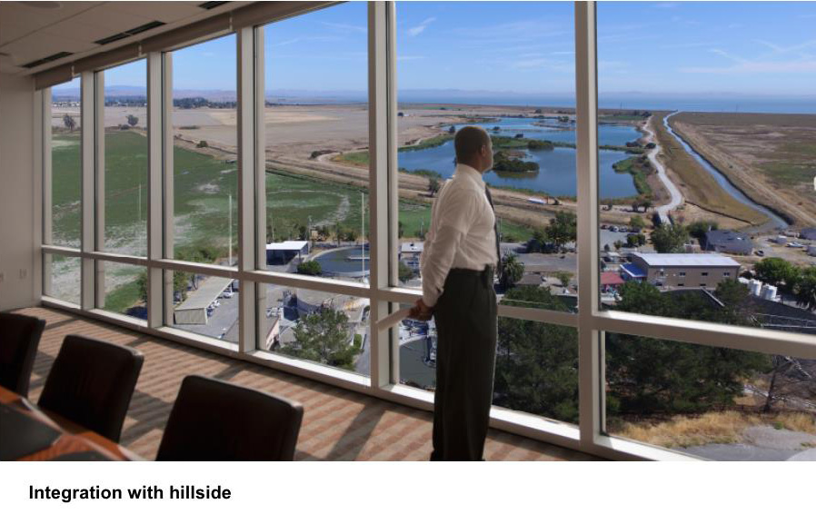
Integrating building with nature
Notes:
Motivation is vital for good business. Participation with the work area is a great advantage

Slide 7
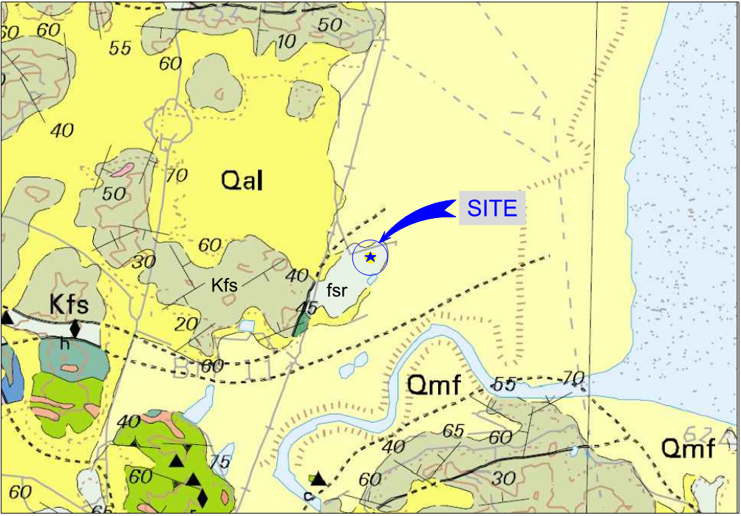
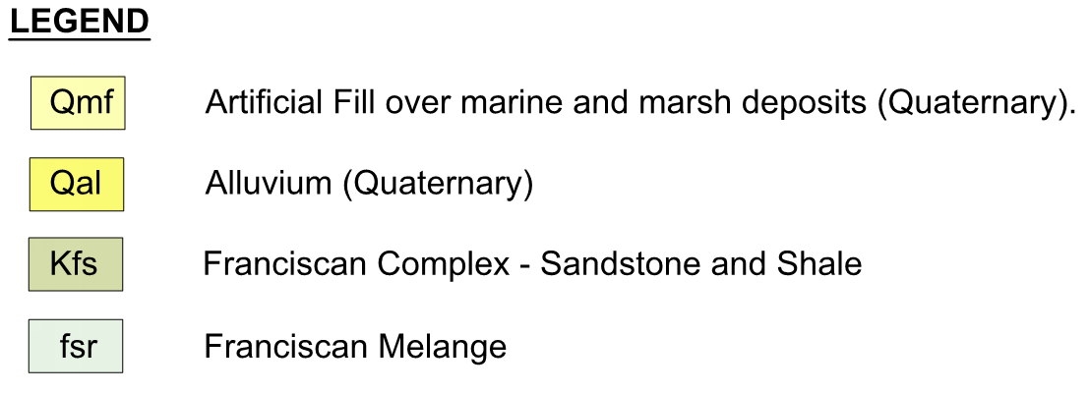
RESPECT GEOTECHNICAL DATA
Notes:
March 2017 Geotechnical report was prepared by Miller Pacific Engineering Group Report.
The area immediately North is Bay Mud

Slide 8
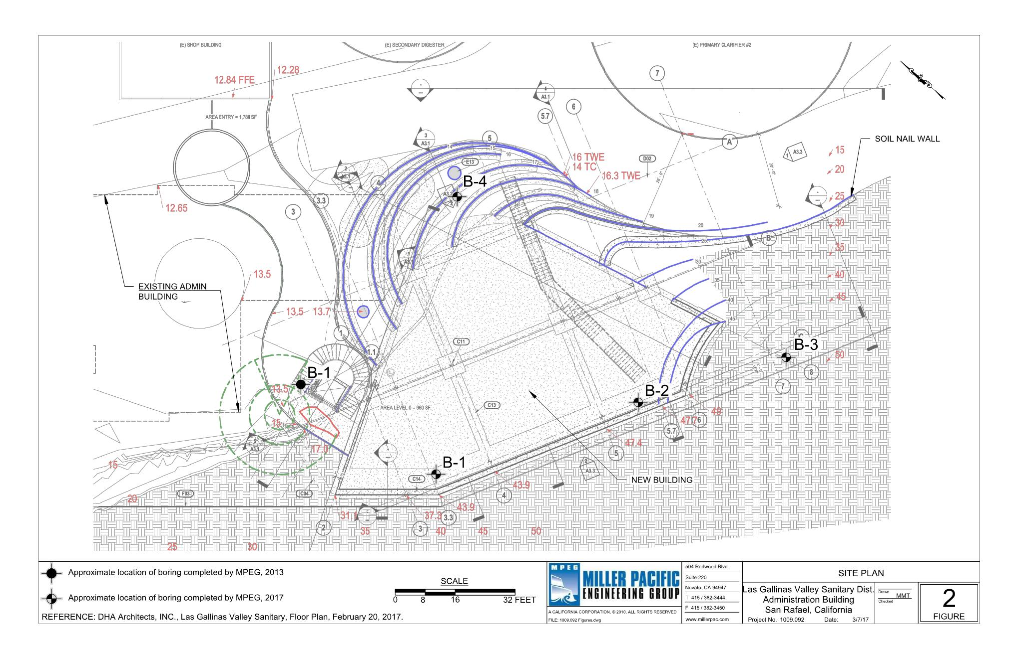
GEOTECHNICAL DATA
1-4
Boring refusal between 9 and 15 feet
Notes:
The 4 boring lab tests show resistant bedrock with auger refusal between 9 and 15 feet.
No slope instability
No erosion conditions
No flood hazard
No risk of expansive soils
No risk of settlement
Use existing facility for staging
No demolition needed prior construction

Slide 9
Let us Say ‘YES’ to our universe!
The site design is to follow environmentally sound appropriation and planning to meet sustainability performance standards for the building.
Keep with the districts Strategic goals to support wildlife habitat, and securing federal and state grant funding for the future projects.
Protect and manage watersheds in determining the future environment of the area as concerned citizens from Las Gallinas Valley area desire, Gallinas Watershed Council (GWC) and Miller Creek Watershed Stewards.
Notes:
Support environmentally sound building standards when determining the future environment

